Slide 1
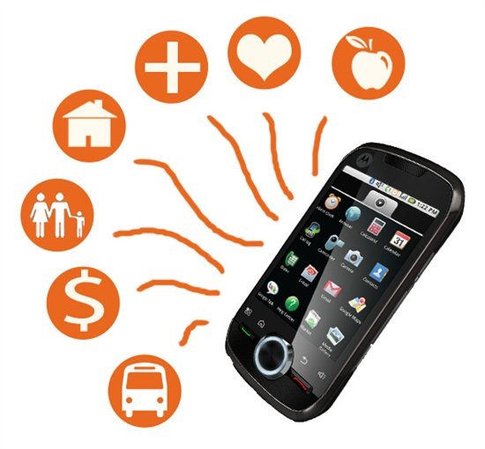
Why are we here?
Reality 1:
There are homeless people
in Santa Clara County.
__#?#__
over 25,000
Reality 2:
Mobile phones are a powerful tool
to help people out of poverty.
Reality 3:
Phones are everywhere…
but with constraints.
Power, Connectivity, Hardware, Data
Mobile phones are a lifeline.

Slide 2

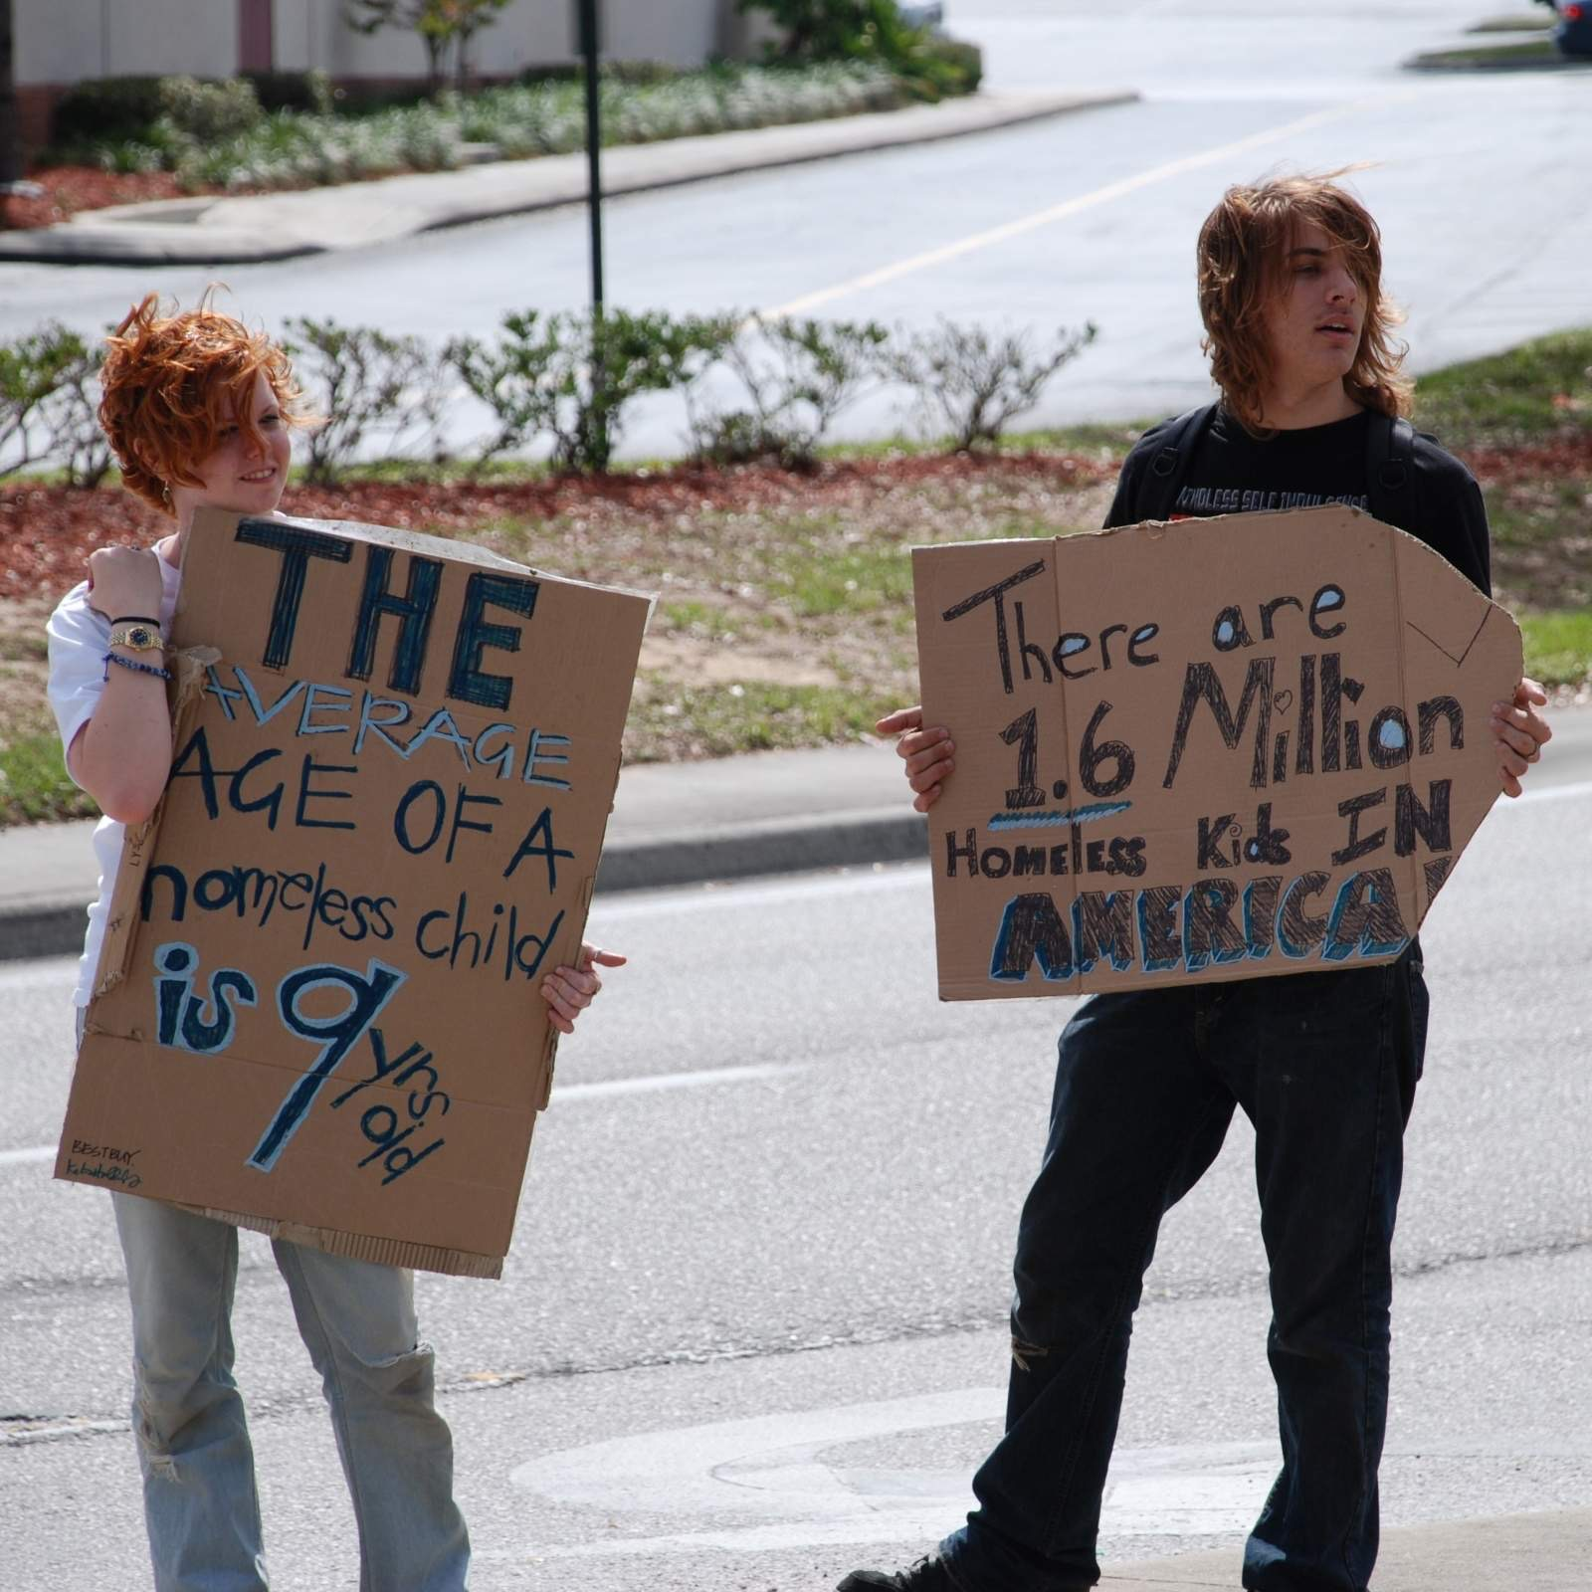
Data Doing Good:
Mastering technology solutions to prevent and end homelessness.
Who are we?
What do we do?
CTA harnesses technologies to empower communities to develop data-driven solutions to poverty and homelessness.

Slide 3
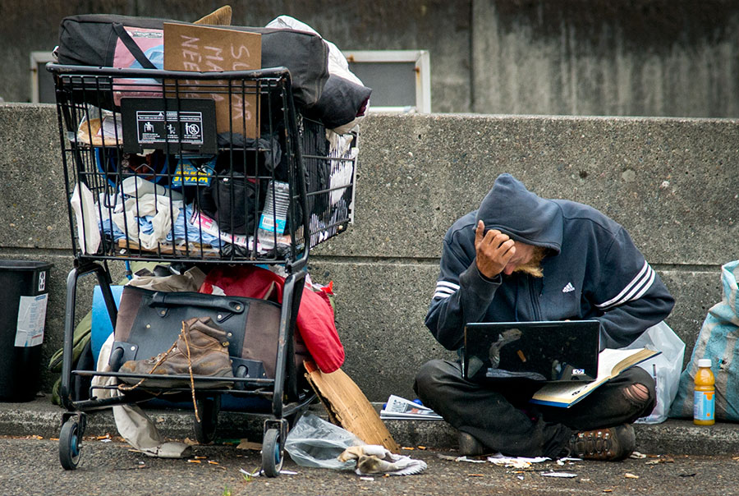
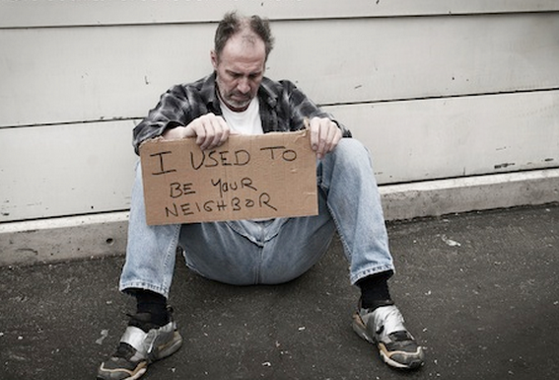
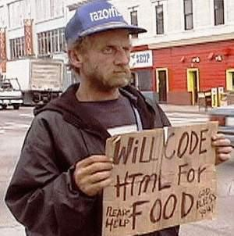
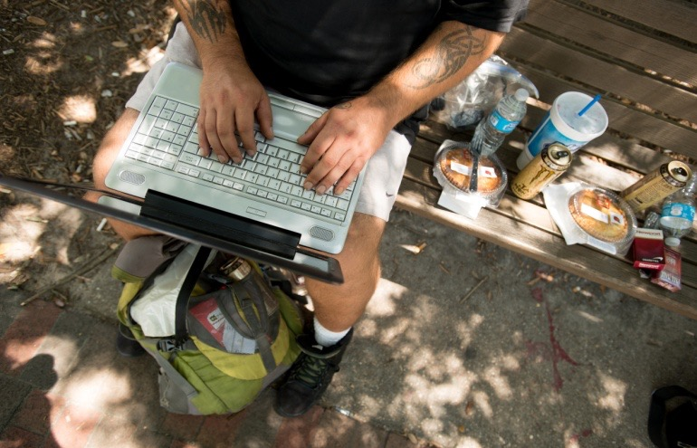
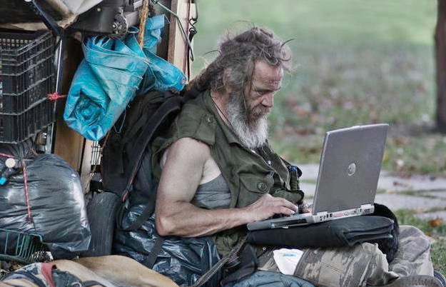
Who are the homeless?

Slide 4
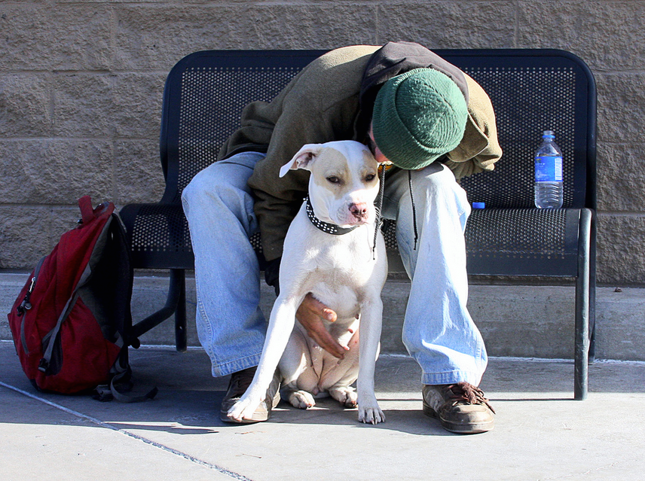
Survey Question 2
There are many reasons people become homeless…
What do you think the main reason is for people being homeless in our country?
Losing His / Her Job
Mental Illness
A Sudden Physical Disability
Drug / Alcohol Abuse

Slide 5
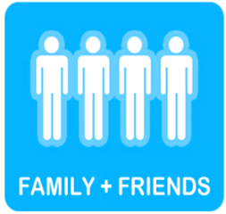


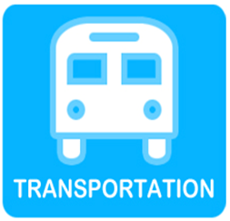






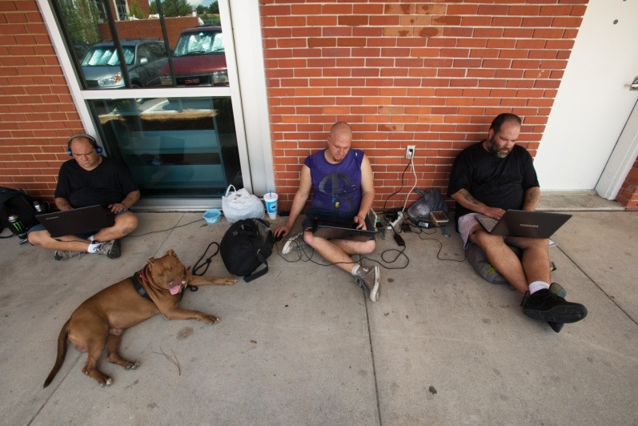
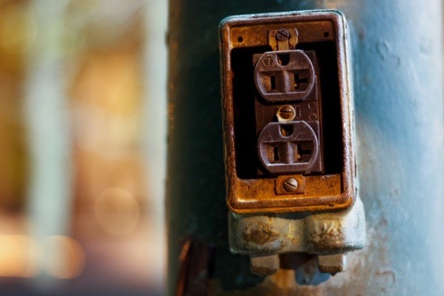
Why does a homeless person need a phone?
Any difference?
What are their limitations?
-Price-
-Handset-
-Coverage-
-Lost or Stolen-
-Nowhere to Charge-
Notes:
Homeless people have to walk long distances to get WIFI access
Get a student for the audience ask for his phone and ask him couple of questions
WHEN WAS THE LAST TIME YOU SPEND ONE DAY OR MORE WITHOUT A PHONE?
WHAT DO you use YOUR PHONE FOR?

Slide 6
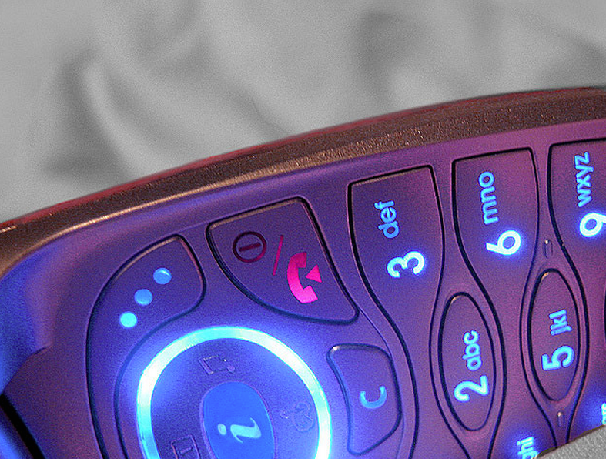
Survey Question 3
How many homeless people in Santa Clara County have a cell phone?
Less than 30%
Between 40% and 60%
Between 60% and 70%
More than 75%
Actual Number: 62%

Slide 7
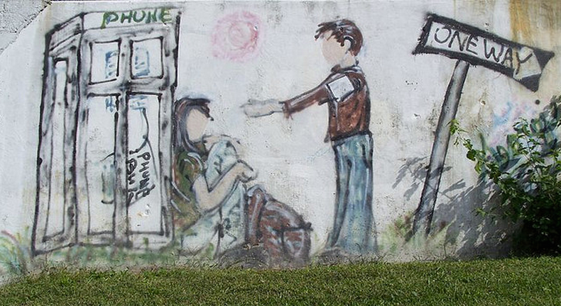
Survey Question 4
How do homeless people pay their phone bill every month?
With their own income.
Somebody pays the bill for him / her.
The phone is used by 2 or 3 people and they chip in to pay for the phone.

Slide 8

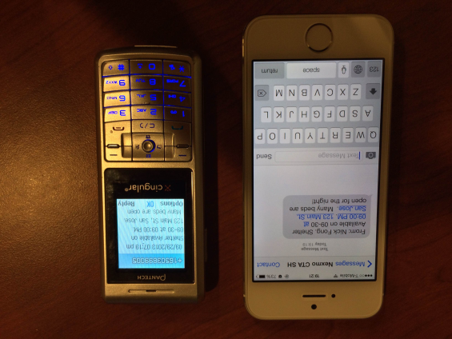
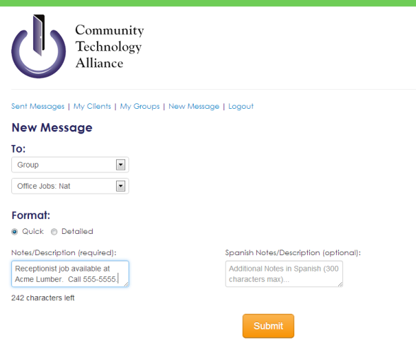

StreetConnect
Service providers and users need to register
Users can select categories
Food
Shelter
Jobs
Etc.
Users can limit number of test messages
SCHOOL OF ENGINEERING

Slide 9
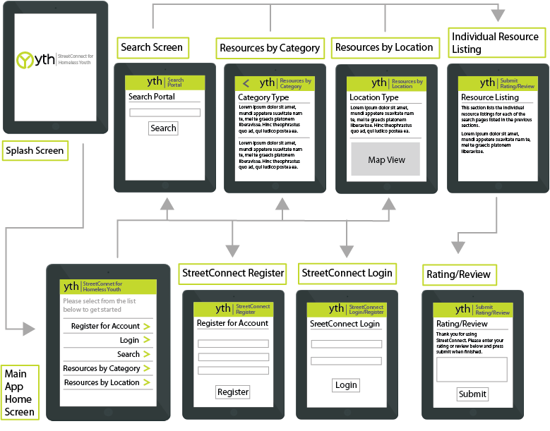
Youth StreetConnect
App enable users to find important resources.
Registration enables health providers to send reminders and important information.

Slide 10
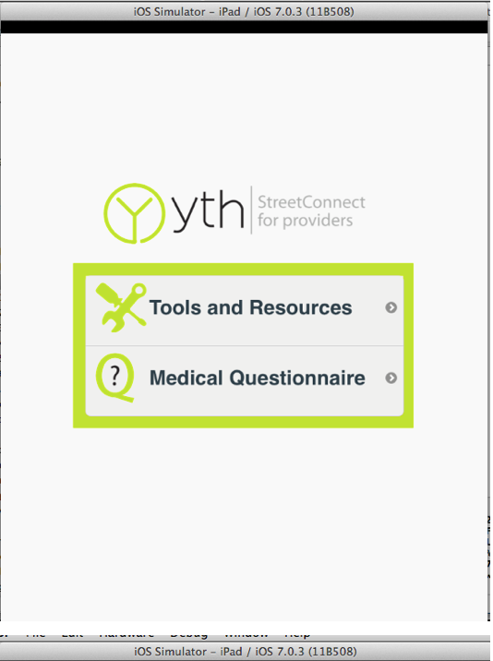
Youth StreetConnect
When young homeless women go to a clinic
Doctors
Use a questionnaire to help raise red flags
Patient
Register to the system
Receive an app with tools and resources

Slide 11

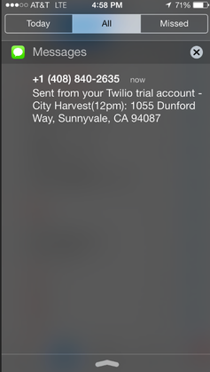
Hack for the Homeless
Homeless HelpLine
Use any mobile phone to locate resources.
Automatically receives text messages to find
free meals or low-cost health clinics.

Slide 12
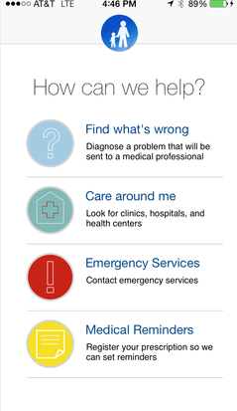
Hack for the Homeless
Modality
Help individuals and families with inadequate access to healthcare:
Self-diagnose ailments,
Connect with local pharmacists or clinics.
Tracks Users’ Medications (QR-Code System)
Sets Reminders
Recommendations stored in a cloud database.

Slide 13
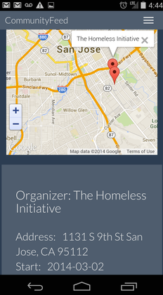
Hack for the Homeless
Community Feed
Free platform that connects food retailers with:
Shelters
Food Banks
Other charitable organizations
Food that would have been wasted goes to
individuals and families in need.

